Slide 1
Intelligent Planning and Modeling for Autonomous Systems

Slide 2
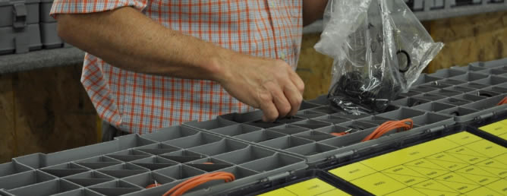


Many Communities – One Data Representation?
Can a uniform data representation be developed to service all communities in:
Order data
Plan data
Environmental information
Can this representation cope with unstructured environments and work around people
Can it be sharable between humans and robots
Part movement and component placement are needed by a large variety of communities
“Kitting” – Staging materials used for assembly process
Packaging – Placing components into set configurations inside containers
Palletizing – Placing components onto pallets for shipment or movement

Slide 3

Workshop
Workshop to be held as part of MODEX show
Bring together interests in multiple component placement communities
Opportunity to brief community on IEEE standards work
Opportunity to discover areas of synergy

Slide 4
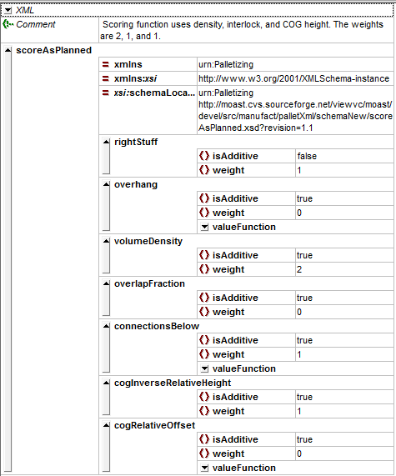
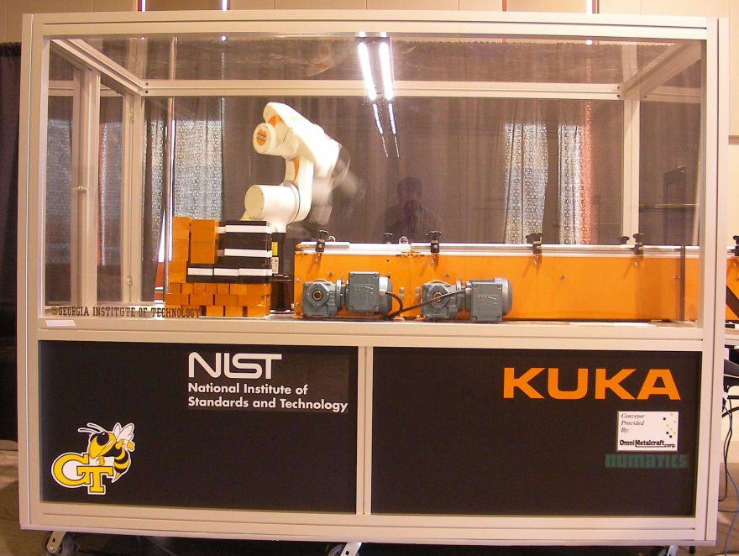
Previous Work
Developed knowledge models for mixed-palletizing and truck loading
Order and plan information
Customizable evaluation metrics
XML schema representation
Visualization tools
Displays results of metrics and view of construction
Both incremental and final statistics presented
Planning systems for creating pallet plans and robotic construction of pallets
Can tools be expanded to work in multiple domains?
Can tools be an aid to human workers and robots?

Slide 5
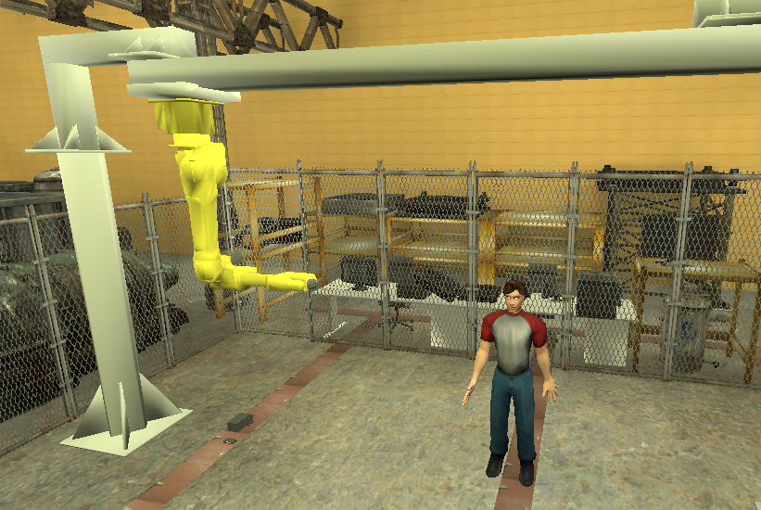
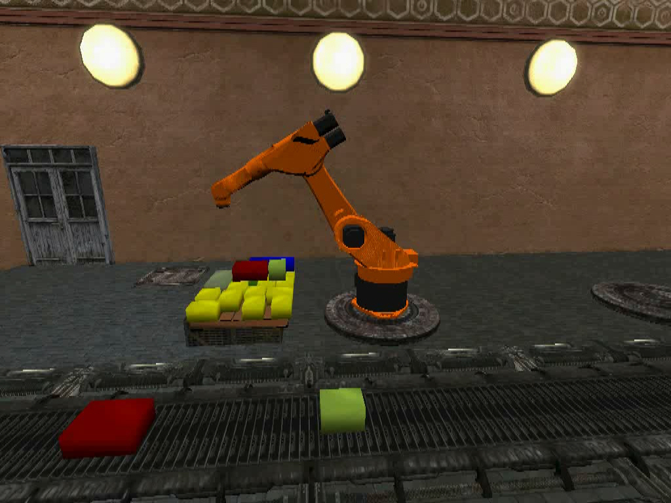
Benefits of Simulation
Much of the development and test of these representations may be performed in simulation
Provides access to sensors that do not currently exist (e.g. victim sensor shown in picture)
Provides access to expensive and dangerous hardware
Provides safe human/robot interaction
We will experiment with data representations, planning systems, performance metrics, and test methods all in simulation before transitioning to actual hardware

Slide 6
Thrust 1: Knowledge Representation
Develop standard representations for world knowledge and plan knowledge
Design implementation that will represent knowledge for assembly tasks requiring rapid re-tasking
Compliant with IEEE working group
Define performance requirements for knowledge
Develop performance methods and metrics
Best practices document?

Slide 7
Thrust 2: Planning
Utilize our knowledge representation to create a planning system for component placement
Investigate standard representations for plan input and output
Define performance requirements for plan
Develop performance methods and metrics
Best practices document?
Develop tools for plan evaluation

Slide 8
Thrust 3: Simulation
Develop new sensors to simulate non-existent vision processing capabilities
Develop world and robots necessary for plan execution
Examine human/robot cooperation

Slide 9
Personnel Allocations
Name | Totals
Balakirsky | 75%
Kootbally | 50%
Kramer | 50%
Madhavan¹ | 33%
Schlenoff | 25%
Unknown | 40%
¹ Raj is not 33% for entire year

Slide 10
General Comments on Outcomes and Outputs
They are intentionally vague
I hope that every one will be exceeded
More information needed (please provide a brief write-up):
Plan for completing objective
Timeline and milestones
What other objects do you need (I have estimated this)?
Are personnel sufficient?
What does it mean to exceed the objective? Can this be done? If so, how?
Are there other deliverables that are not mentioned that make sense?

Slide 11
FY 2010 Milestones, Outputs, and Outcomes: Thrust 1Q1
Output - Create a draft of a representation for the semantic world knowledge that is capable of supporting a priori and static knowledge gathered from sensors and databases. This knowledge will support next generation robotics for the general class of manufacturing problems in the area of component placement and will be coordinated with the IEEE working group. (Schlenoff & Kramer)
Output - Workshop at IROS to establish relationship with IEEE RAS Knowledge Representation for Robotics and Automation study group and keep the group aware of our work in representations. (Schlenoff)

Slide 12
FY 2010 Milestones, Outputs, and Outcomes: Thrust 2 Q1
New personnel come up to speed on USARSim and MOAST (Unknown)

Slide 13
FY 2010 Milestones, Outputs, and Outcomes: Thrust 3 Q1
Output - Create and circulate a planning document in the USARSim community that outlines an implementation strategy for developing the ability to include high-level semantic knowledge in the simulation. (Balakirsky & Kootbally)

Slide 14
FY 2010 Milestones, Outputs, and Outcomes: Thrust 1Q2
Outcome - Industry workshop where representatives from the kitting, packaging, and palletizing industries will come together to discuss common problems in component placement and provide input to the IEEE working group. This will occur at the Modex show on 6-12 Feb in Atlanta, GA. (Madhavan & Schlenoff)
Output – Deliver preliminary KR and planning performance measures and tools to IEEE working group. (Kramer & Schlenoff)

Slide 15
FY 2010 Milestones, Outputs, and Outcomes: Thrust 2 Q2
Output - Develop a simulation based planning system based on leading edge techniques for creating packaging static plans. This system will use a simple world model representation, and will include a simulated world, robot models, and new sensors for delivering semantic world knowledge. (Balakirsky, Kootbally & other)

Slide 16
FY 2010 Milestones, Outputs, and Outcomes: Thrust 3 Q2
None

Slide 17
FY 2010 Milestones, Outputs, and Outcomes: Thrust 1Q3
Outcome - Project Authorization Request (PAR) accepted by IEEE and Knowledge Representation for Robotics and Automation Working Group formed. (Schlenoff)

Slide 18
FY 2010 Milestones, Outputs, and Outcomes: Thrust 2 Q3
Output - Deliver a tool set that allows planning and sensor processing systems to easily query and utilize the information stored in the world model. (Kramer)

Slide 19
FY 2010 Milestones, Outputs, and Outcomes: Thrust 3 Q3
Outcome - Deliver an integrated system that allows virtual sensing of high-level semantic knowledge to be extracted from the simulation. (Balakirsky & Kootbally & Other)

Slide 20
FY 2010 Milestones, Outputs, and Outcomes: Thrust 1Q4
Output - Develop a sample implementation of the IEEE working group’s KR as it applies to component placement and an automatic tool for evaluating simulated performance measures. (Schlenoff & other)

Slide 21
FY 2010 Milestones, Outputs, and Outcomes: Thrust 2 Q4
Outcome - Deliver evaluation tools that allow various planning approaches that utilize our KR to be compared and a NIST-IR that contains performance measures for planning. (Kramer)
Output - Develop a planning system capable of dynamic planning (changing the plan based on the world model). (Balakirsky & Kootbally)

Slide 22
FY 2010 Milestones, Outputs, and Outcomes: Thrust 3 Q4
Output - Create a NIST-IR or conference paper detailing the extensions to the simulation framework. (Balakirsky & Other)

Slide 23
Competitions
We have a long and successful history in competitions
Should VMAC be continued?
What would be the new thrust?
Who would participate?
If no VMAC, should we spin it off to another group?

Slide 24
Project Management Structure
Performance reviews are structured to take into account success of outputs and outcomes
Brief weekly meeting to discuss each task

